Slide 1
NEW WORSHIPPING COMMUNITIES & Healthy Churches
Diocesan Synod, 15 March 2025

Slide 2
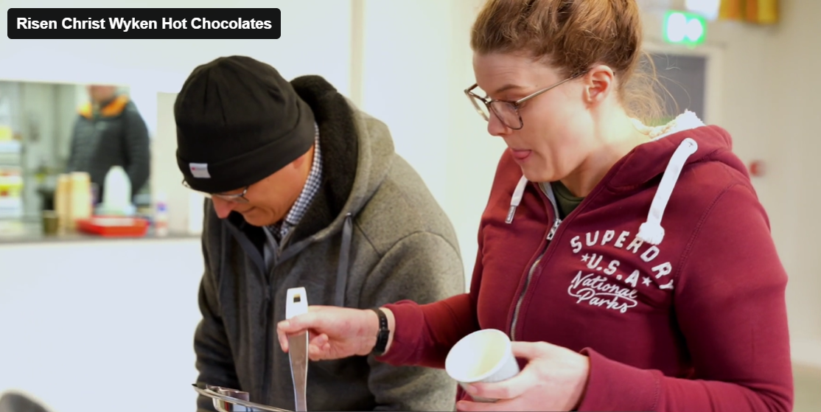
New Worshipping Communities
New Youth Group, All Saints, Stoke

Slide 3
The Journey
Paradigm
Education
Truth
Blowing the Mind
Culture & Structures
Immersion
Beauty
Shaping the Soul
Practices
Enabling
Goodness
Engaging the Will

Slide 4
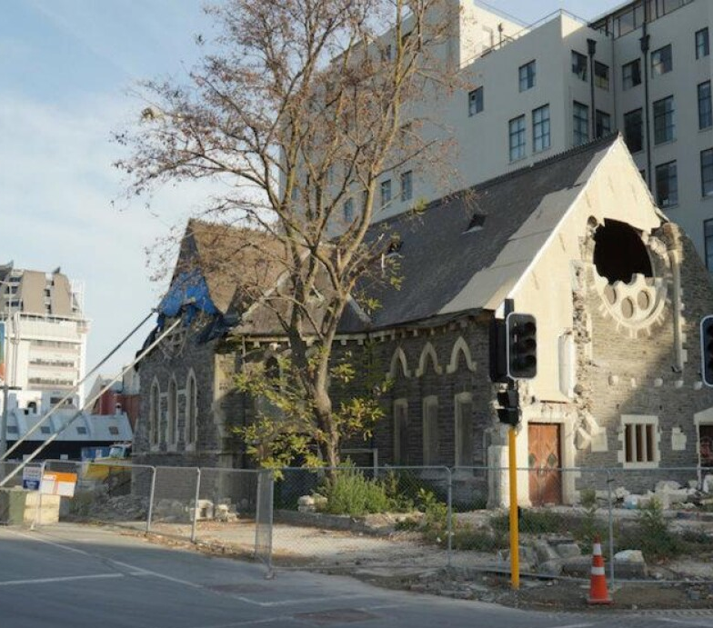
Challenges

Slide 5
The Compass Natural Church Development, Christian Schwarz
Father, Creator
Creation
Justice
Holy Spirit
Experience
Affective
Spiritual Power
Son
Word
Proactive

Slide 6
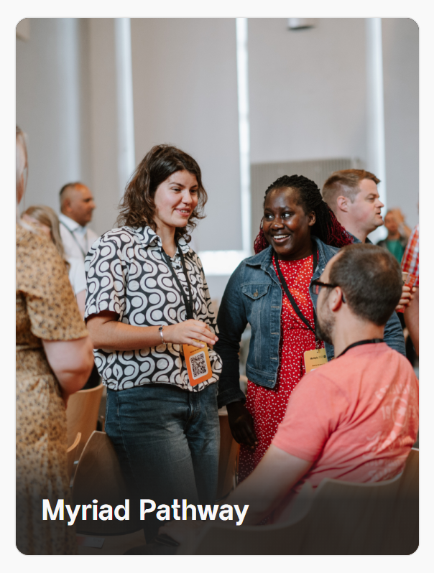
CATALYSTS TO ACTION
Greenhouse

Slide 7
Healthy Churches
FORMING HEALTHY RELATIONSHIPS
The world we live in
Spiritual interest versus religion
Mission and Ministry beyond church walls
COLLECTIVE PRAYER & DEEPENING ROOTS
Accompanying
Intercessions
Prayer themes across the Diocese
CHURCH GROWTH
Church as place of encounter
Faith experiences shared
Momentum built

Slide 8
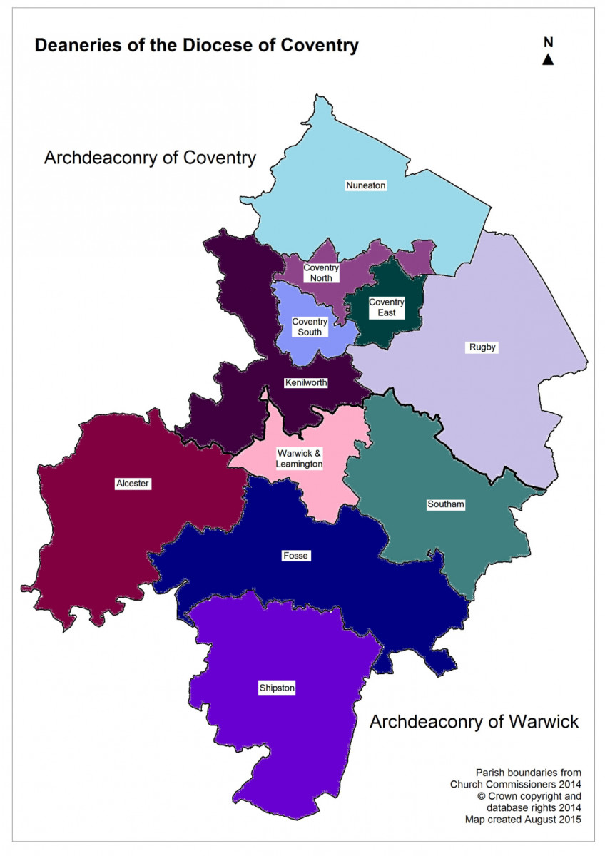
Reflection
Where are you?
Where is your church?

Slide 9
Questions
Which healthy new worshipping communities
can we learn from?
What barriers are there to planting
healthy new worshipping communities?

