Slide 1


Safeguarding Audit 2026
It’s here!
coventry.anglican.org/walking

Slide 2
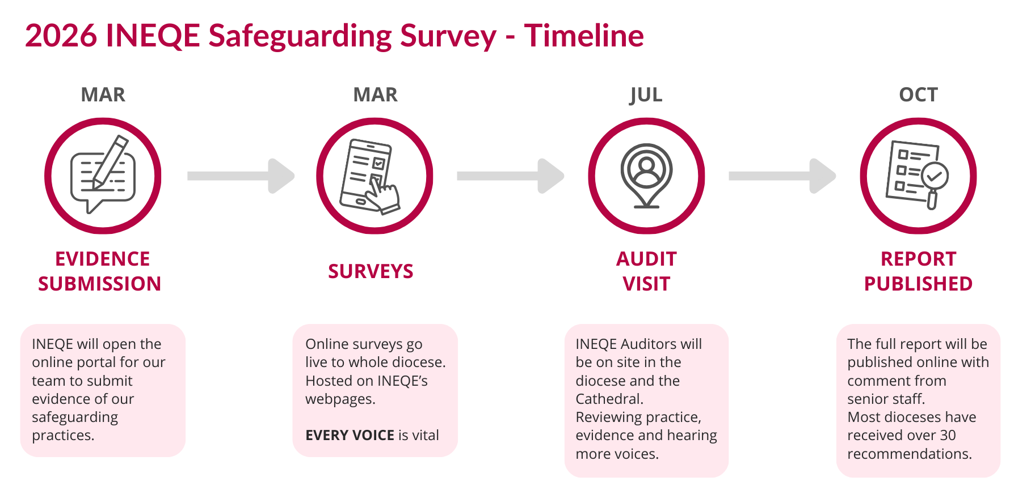
Timeline
coventry.anglican.org/walking

Slide 3
What will they look at?
At parish level
Key areas of evidence will INEQE look at;
  Parish dashboards
  Safeguarding training up to date for key roles Church Wardens, PSO, PCC members, Lay and ordained leaders
  Safer recruitment how this is recorded and tracked at parish level
coventry.anglican.org/walking

Slide 4



The Safeguarding Survey
coventry.anglican.org/walking

Slide 5
Preparing for the Survey
Tell
Tell people it’s coming.
Teach
Teach about how it’s a gospel imperative.
Tend
Tend to specific services and groups.
Transform
Talk about how this will help us.
Treasure
Celebrate people and groups who take part.

Slide 6
Support & Resources
Print Media
Posters and Postcards in your pack
Take more if you need
Digital
Screens for notices, foyers, pre & Post services.
coventry.anglican.org/walking

Slide 7
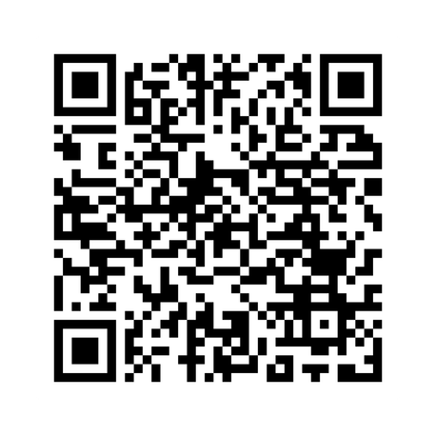



The
SAFEGUARDING
SURVEY
2026
O

Slide 8
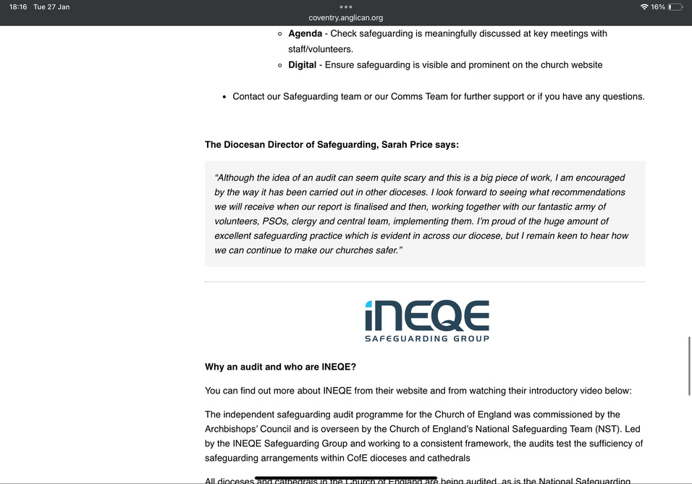
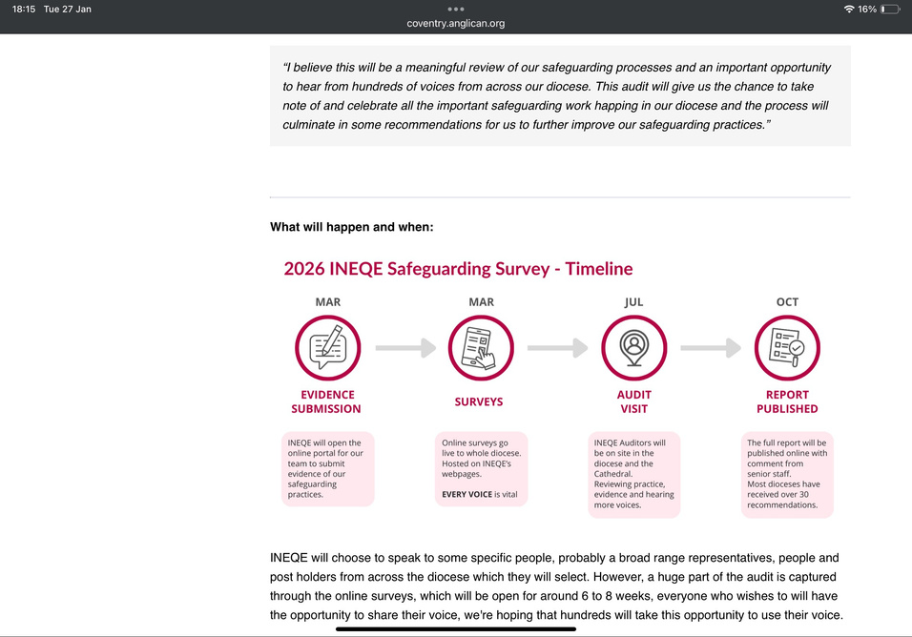
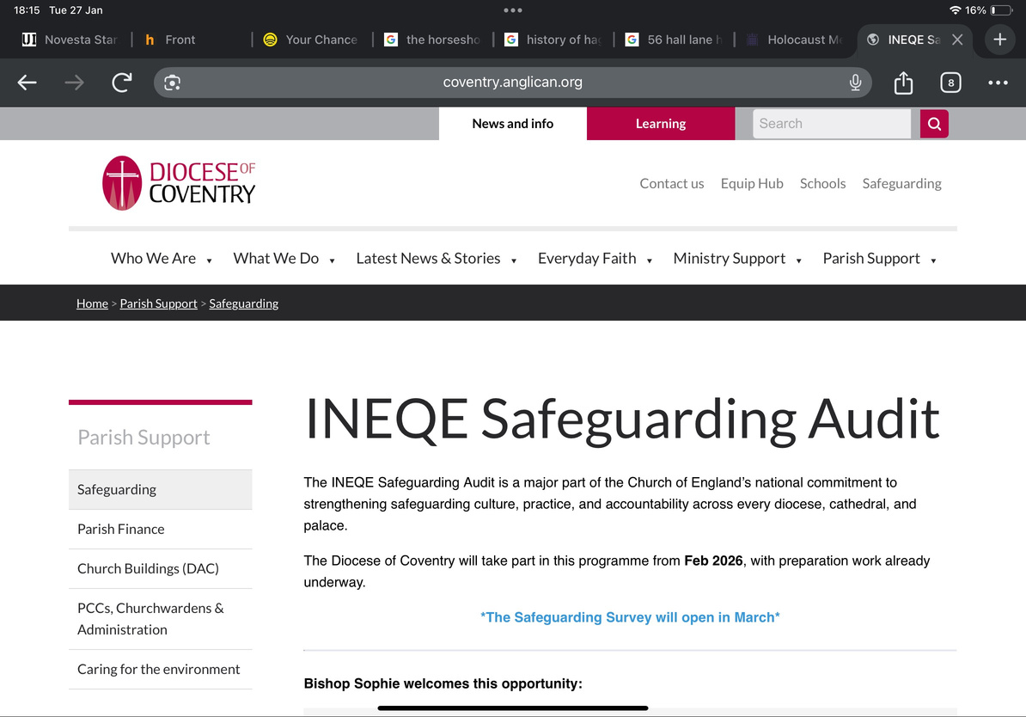

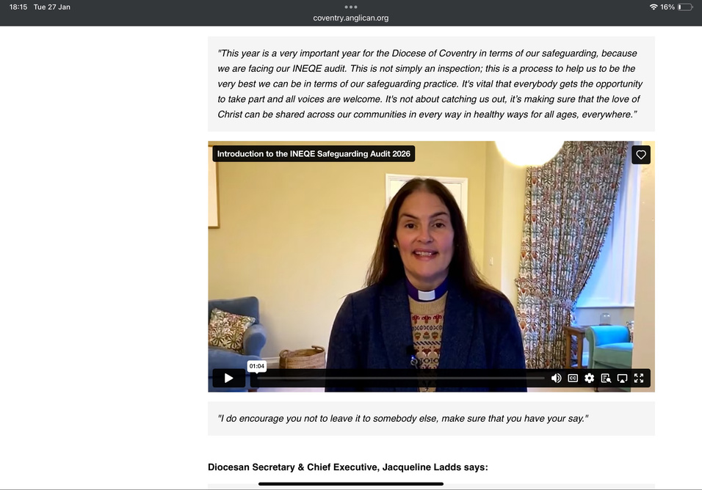
Support & Resources
Website
Lot’s of info, quick tips, drop-in sessions and video

Slide 9
Safeguarding Audit 2026
Very much here!
coventry.anglican.org/walking

